Slide 1
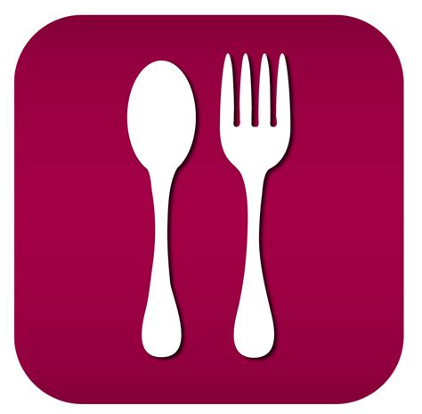

Best location to open a Cafe in Bengaluru

Slide 2
Cafe in Bengaluru, because we love Food!
Bengaluru is one the India's IT hub
This city famous for its parks,malls and nightlife. Its sometimes referred to as the “Silicon valley of India“
Being an IT hub, its also a great place for businesses like malls, cinema and recreational places as most of the people here are dependent mainly on the restaurant food as they don’t have time to cook for themselves
With such an overwhelming demand for restaurants, it has become important to study the demography of a location and to understand the restraurant business across the city

Slide 3
Data
Data scraping from zomato for cafes in Banglore
Location coordinates from geopy
Neighborhood ratings from Foursquare api
Data had around 5090 cafes across with 13 columns for various features
Basic data cleaning and treatment
Link to data scraped from Zomato: here

Slide 4
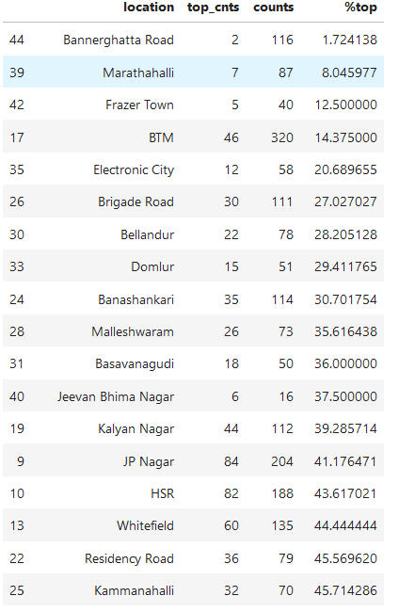
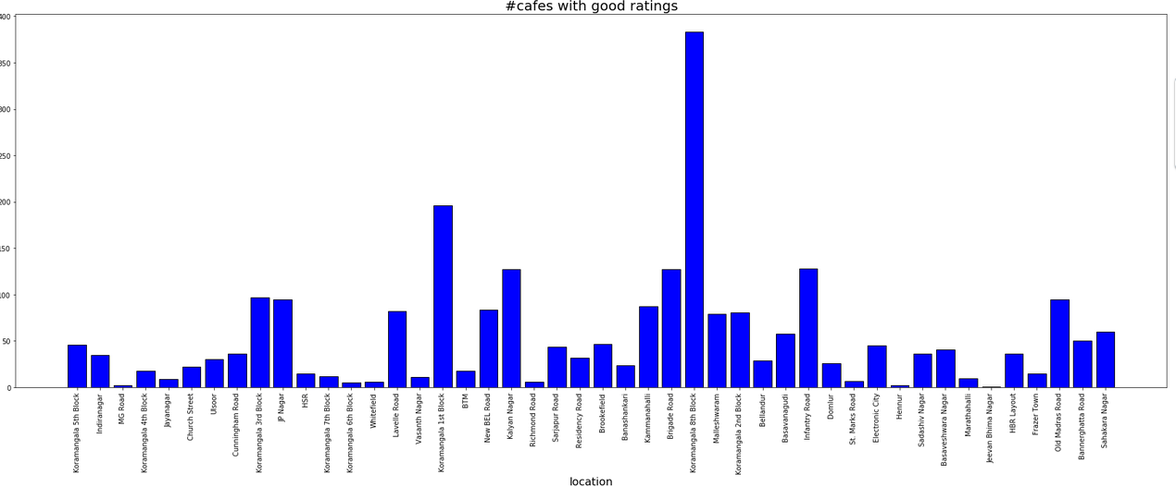
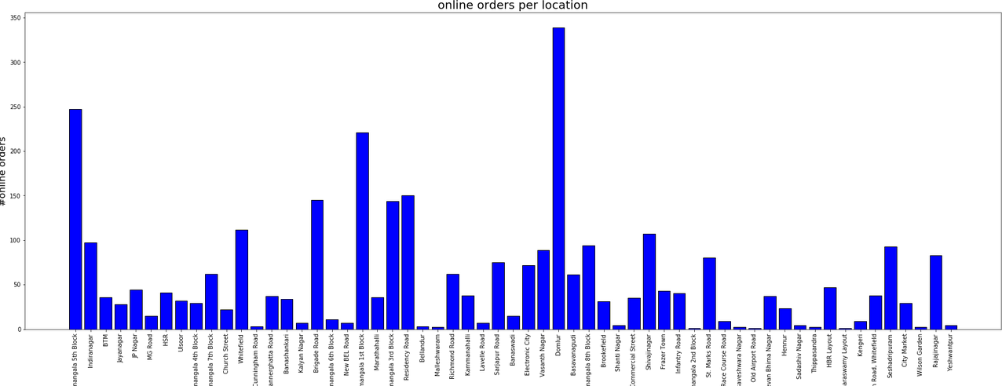
Analysis
#best rated cafes/total# cafes to understand the location with necessity for a good cafe
To obtain #cafes per location which had more than 4/5 rating
To obtain #cafes per location which had most #online orders

Slide 5
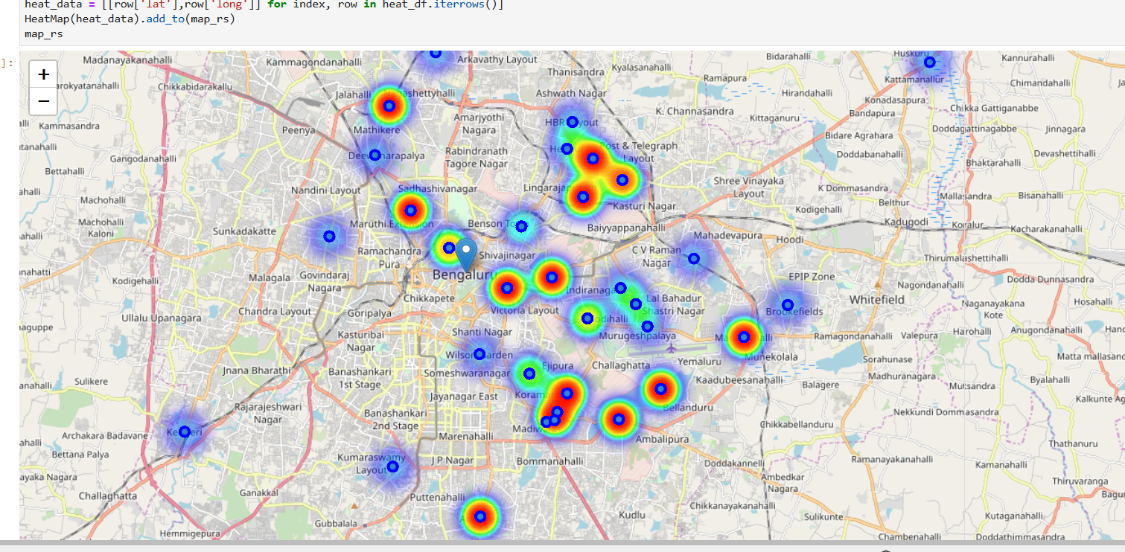
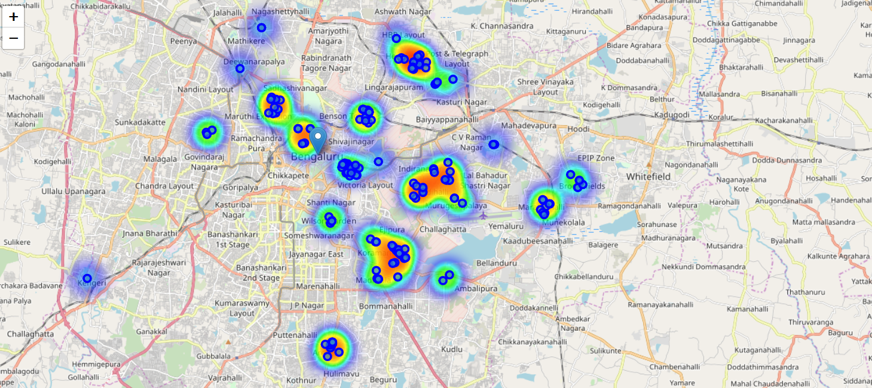
Analysis
Location heat map showing cafes across Bangalore.
Location heat map showing neighbourhood restaurants across Bangalore

Slide 6
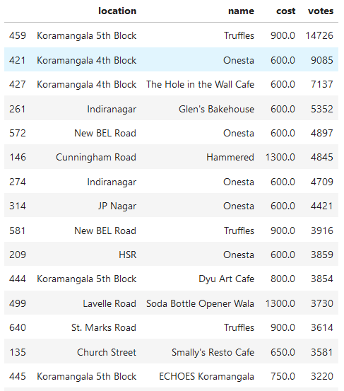
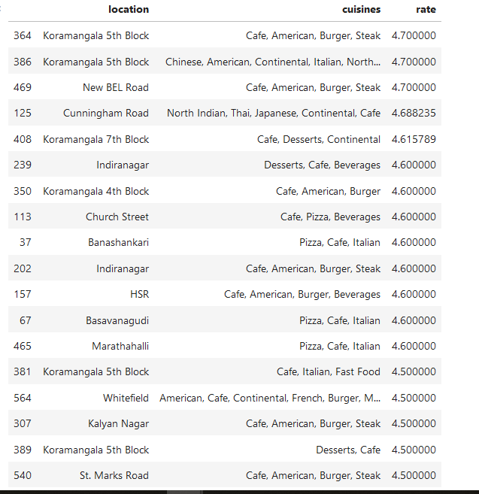
Analysis
Location wise cafe popularity vs cost
Location wise best rated cuisines

Slide 7
Results
Most cafes are present in areas: Koramangala, Indiranagar, BTM, Jayanagar, JP Nagar, MG Road, HSR and Ulsoor
Cafe loctions with most online orders are Domlur, Kormangala, Brigade road, Indira nagar, Sheshadripuram, Sarjapur and Electronic city
Locations with high average cafe rating are: Koramangala, Indiranagar, MG Road, Jayanagar, Church Street, Ulsoor, Cunningham Road, JP Nagar and HSR
Cafes with low, high rated cafes (<50% for # top rated/# total cafes) are Bannerghatta Road, Marathahalli, Frazer Town, BTM, Electronic City, Brigade Road, Bellandur, Domlur, Banashankari, Malleshwaram, Basavanagudi, Jeevan Bhima Nagar, Kalyan Nagar, JP Nagar, HSR, Whitefield, New BEL road and couple of others
Top rated cuisines are American burger, Continental, Desserts, Pizza and Italian
Range of cost for two, for most popular cafes: 600-900
Most popular locations by votes are Kormangala, Indira nagar, New BEL road, JP Nagar, HSR, Lavelle road and Church Street

Slide 8
Insights and Recommendations
Starting with locations where most people visit and those where high rated are few, so that there is low competition are New BEL road and HSR.
However, looking at number of cafes around HSR have many, as compared to New BEL road
But if we want to be open for online ordering service as well, then HSR is better
So based on the budget, either of the locations will be good
With cost for two around 600-900 and cuisine in continental / desserts / Italian are other recommendations

Slide 9
Conclusion
Although analyzing different restaurants data can help in this analysis, factors like age group, economy of the location will be affecting the real world scenario
However, considering different factors mentioned in this case, conclusion is that opening a new Cafe in HSR would be a best option with 600-900 cost with Continental/Italian/dessert cuisine

